Slide 1
Analysis in Mobility Dataset

Slide 2
Dataset
MiD 2017 ¶
Mobilität in Deutschland
Size: 892627 data points( travel length)
NHTS17
Travel behavior of the American public
Size: 923572 data points

Slide 3
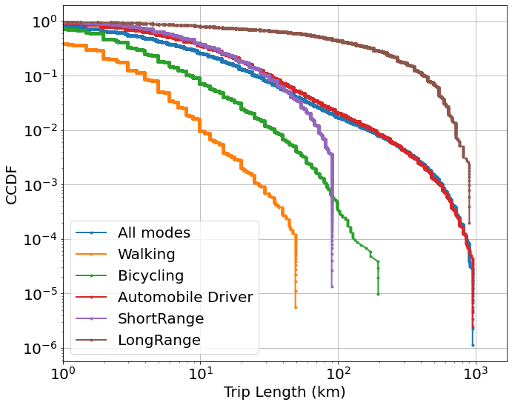
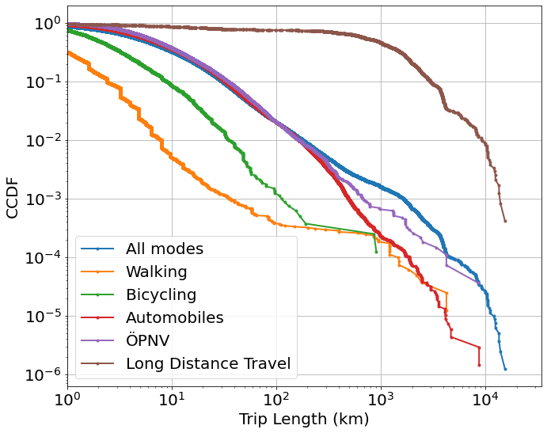
CCDF of both datasets
MiD 2017¶
Nhts 2017¶

Slide 4
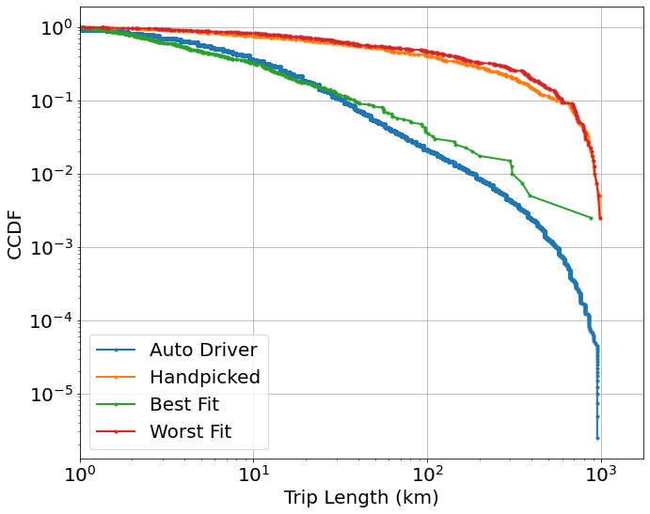
Modelling-Auto Driver in MiD 2017
Auto Driver in MiD 2017
Best fit error:
0.911323857533286
Worst fit error
105.82166593731804
messpt=[1, 3, 5.5, 10, 30, 55, 100, 300]
Largest distance=1000
 | eps | p | alpha
Hand picked | 2 | 0.7 | 1.1
Best fit | 0.35 | 0.75 | 2.1
Worst fit | 1.3 | 0.9 | 1.1

Slide 5
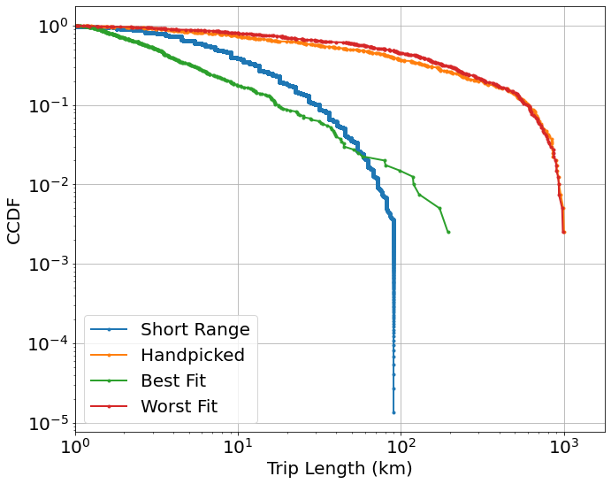
Modelling-Short Range Public in MiD 2017
Short Range Public in MiD 2017
Best fit error:
1.5058163562686924
Worst fit error
94.0877277719395
messpt=[1, 3, 10, 30, 55,75]
Largest distance=1000
 | eps | p | alpha
Hand picked | 2 | 0.7 | 1.1
Best fit | 0.15 | 0.7 | 1.95
Worst fit | 1.6 | 0.9 | 1.1

Slide 6
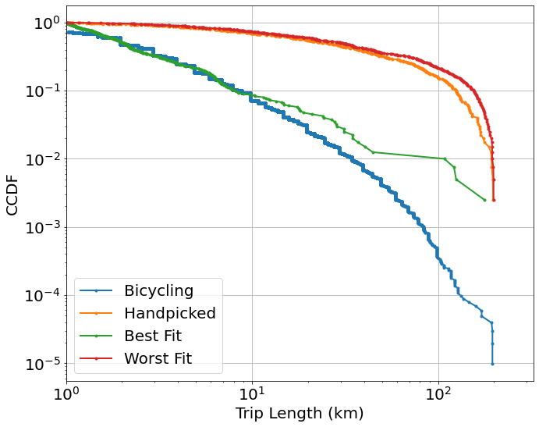
Modelling-Bike in MiD 2017
Short Range Public in MiD 2017
Best fit error
3.288817073050719
Worst fit error
2794.392094461695
messpt=[1,3,5,7,10,30,55,70,100,150]
Largest distance=200
 | eps | p | alpha
Hand picked | 2 | 0.7 | 1.1
Best fit | 0.8 | 0.2 | 2.25
Worst fit | 1.15 | 0.85 | 1.1

Slide 7
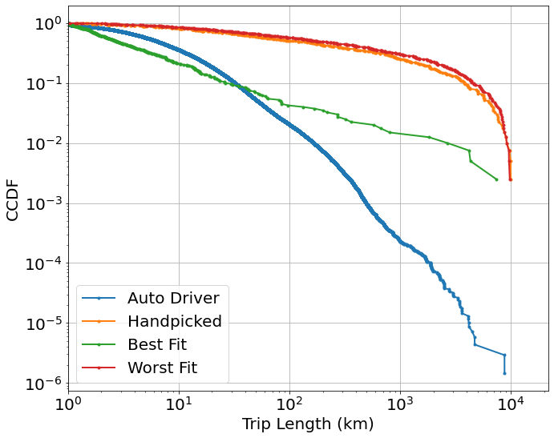
Modelling-Auto Driver in Nhts17
Auto Driver in Nhts17
Best fit error:
4.735972294671592
Worst fit error
79207.5322810473
messpt=[ 10, 55, 100, 300,700,1000,5000,7000]
Largest distance=10000
 | eps | p | alpha
Hand picked | 2 | 0.7 | 1.1
Best fit | 0.2 | 0.1 | 1.7
Worst fit | 1.55 | 0.9 | 1.15

Slide 8
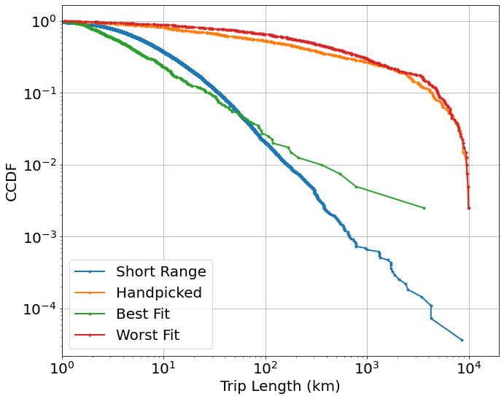
Modelling-Short Range Public in Nhts17
Short Range Public in Nhts17
Best fit error:
4.626965372099182
Worst fit error
6814.1343928215965
messpt=[ 10, 55, 100, 300,700,1000,5000,7000]
Largest distance=10000
 | eps | p | alpha
Hand picked | 2 | 0.7 | 1.1
Best fit | 0.05 | 0.9 | 1.85
Worst fit | 1.1 | 0.9 | 1.1

Slide 9

Modelling-Short Range in Nhts17-New Params Selected
Auto Driver in Nhts17
Best fit error:
7.13150404698985
Worst fit error
8828.427163972436
p_range=np.arange(0.01, 0.95, 0.03)
eps_range=np.arange(0.1,2,0.03)
Messpt= [1,3,5,7,10, 30, 55, 70,100, 300,500,700,1000,5000,7000]
Largest distance=10000
 | eps | p | alpha
Hand picked | 2 | 0.7 | 1.1
Best fit | 1.6 | 0.46 | 2.25
Worst fit | 0.85 | 0.94 | 1.15

Slide 10

Modelling-Short Range in Nhts17-New Params Selected-New Error function
Auto Driver in Nhts17
Best fit error:
4.454465769303726
Worst fit error
1698.783816378225
p_range=np.arange(0.01, 0.95, 0.03)
eps_range=np.arange(0.1,2,0.03)
Error: Wasserstein distance (the earth mover’s distance,)
Largest distance=10000
 | eps | p | alpha
Hand picked | 2 | 0.7 | 1.1
Best fit | 0.4 | 0.67 | 2.15
Worst fit | 0.79 | 0.94 | 1.1

Slide 11

Modelling-Short Range in Nhts17-New Params Selected-New Error function- p can be 0
Auto Driver in Nhts17
Datasize=27421
Best fit error:
4.7520321181153875
Worst fit error
1662.7523100247206
p_range=np.arange(0, 0.95, 0.03)
eps_range=np.arange(0.1,2,0.03)
Error: Wasserstein distance (the earth mover’s distance,)
Largest distance=10000
 | eps | p | alpha
Hand picked | 2 | 0.7 | 1.1
Best fit | 0.25 | 0.81 | 2.2
Worst fit | 1.81 | 0.9 | 1.1

Slide 12
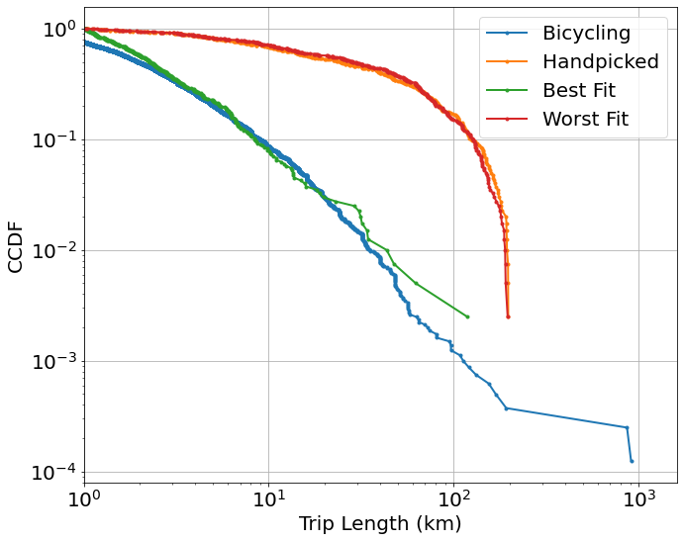
Modelling-Bike in Nhts17
Short Range Public in Nhts17
Best fit error:
3.08572583406345
Worst fit error
547.2482490075568
messpt[ 1,3,5,7,10,30,55,70,100,200]
Largest distance=200
 | eps | p | alpha
Hand picked | 2 | 0.7 | 1.1
Best fit | 0.65 | 0.25 | 2.1
Worst fit | 1.9 | 0.9 | 1.1

Slide 13
Questions
what is the messpt?
#trip lengths at which the difference between list of distance and model output is determined and summed up
messpt=[1, 3, 5.5, 10, 30, 55, 100, 300]
But when modelling the Srpublic in MiD2017
(1-ECDF(df_vec)(e))=0 when messpt =100 or 300
Result in→ error = nan or inf
Just simply remove?
What is the largest distance should be in Nhts dataset
It’s 1000km in MiD 2017
-----Solved

Slide 14
Re-modelling of data over 10km Especially for the long distance transport modes

Slide 15
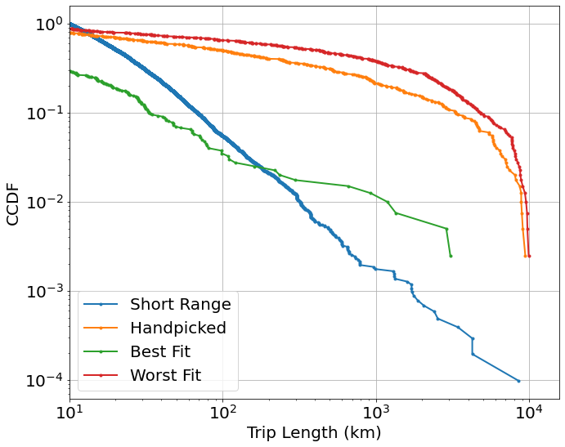
Modelling-Short Range in Nhts17-New Params Selected-New Error function- p can be 0-modelling over 10km
Auto Driver in Nhts17
Datasize=10240
Best fit error:
18.507777898700443
Worst fit error
1659.0998960077702
p_range=np.arange(0, 0.95, 0.03)
eps_range=np.arange(0.1,2,0.03)
Error: Wasserstein distance (the earth mover’s distance,)
Largest distance=10000
 | eps | p | alpha
Hand picked | 2 | 0.7 | 1.1
Best fit | 0.95 | 0.6 | 2.2
Worst fit | 1.99 | 0.93 | 1.1

Slide 16
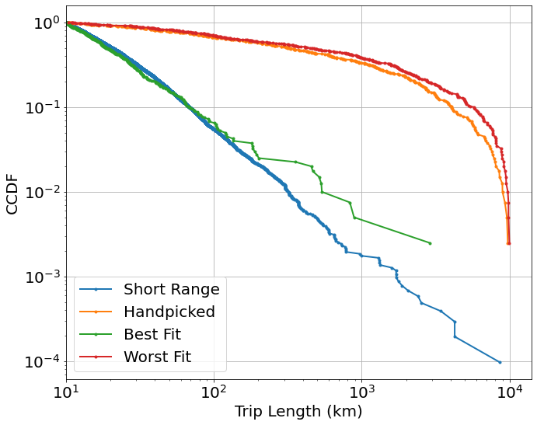
Modelling-Short Range in Nhts17-New Params Selected-New Error function- p can be 0-modelling over 10km
Auto Driver in Nhts17
Datasize=10240
Best fit error:
4.688603224779429
Worst fit error
1923.568854148891
p_range=np.arange(0, 0.95, 0.03)
eps_range=np.arange(0.1,2,0.03)
Error: Wasserstein distance (the earth mover’s distance,)
Largest distance=10000 and shortest>10
 | eps | p | alpha
Hand picked | 2 | 0.7 | 1.1
Best fit | 0.91 | 0.42 | 2.4
Worst fit | 1.93 | 0.93 | 1.1

Slide 17
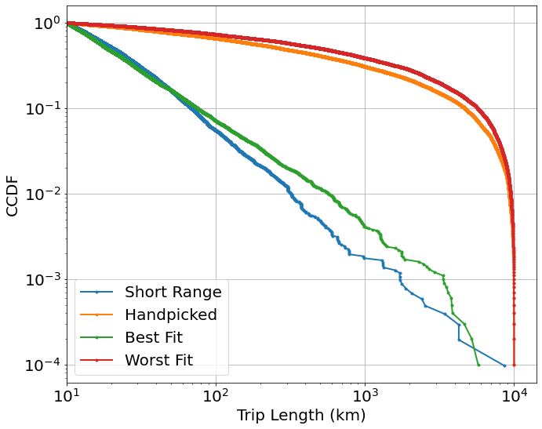
Modelling-Short Range in Nhts17-New Params Selected-New Error function- p can be 0-modelling over 10km
Auto Driver in Nhts17
Datasize=10240
Best fit error:
4.688603224779429
Worst fit error
1923.568854148891
p_range=np.arange(0, 0.95, 0.03)
eps_range=np.arange(0.1,2,0.03)
alp_range=np.arange(1.1, 2.5,0.05)
Error: Wasserstein distance (the earth mover’s distance)
Largest distance=10000 and shortest>10
#Samples: 400 Visualization:10000
 | eps | p | alpha
Hand picked | 2 | 0.7 | 1.1
Best fit | 0.91 | 0.42 | 2.4
Worst fit | 1.93 | 0.93 | 1.1

Slide 18
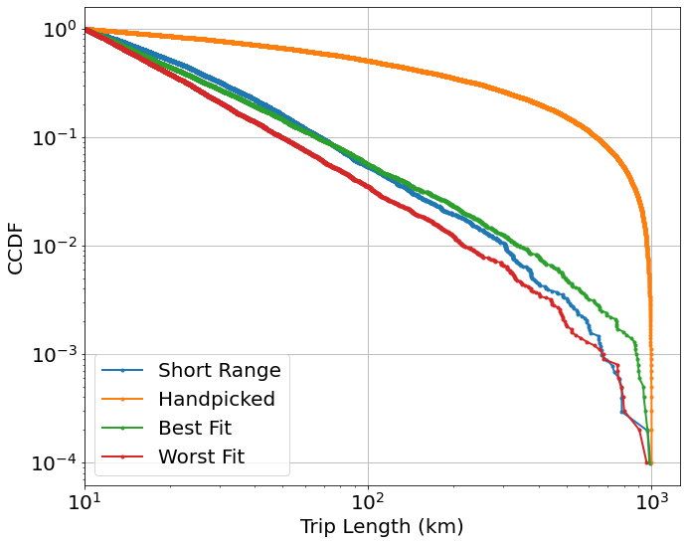
Refine Best Fit-Short Range in Nhts17-modelling between 10~1000km
Auto Driver in Nhts17
Datasize=10223
Best fit error:
2.1135655984394757
Worst fit error
9.724983552616898
eps_range=np.arange(0.85,0.95,0.01)
p_range=np.arange(0.35, 0.45, 0.01)
alp_range=np.arange(2.4, 2.7,0.05)
Error: Wasserstein distance (the earth mover’s distance,)
Largest distance=1000 and shortest>=10
# Samples:
Modelling(2000), Visualization(10000)
 | eps | p | alpha
Hand picked | 2 | 0.7 | 1.1
Best fit | 0.89 | 0.4 | 2.45
Worst fit | 0.86 | 0.36 | 2.7

Slide 19

Refine Best Fit-Short Range in Nhts17-modelling between 10~1000km
Auto Driver in Nhts17
Datasize=10223
Best fit error:
2.5846170337106087
Worst fit error
8.766310430297988
eps_range=np.arange(0.85,0.95,0.01)
p_range=np.arange(0.35, 0.45, 0.01)
alp_range=np.arange(2.4, 2.7,0.05)
Error: Wasserstein distance (the earth mover’s distance,)
Largest distance=1000 and shortest>=10
# Samples:
Modelling(10000), Visualization(10000)
 | eps | p | alpha
Hand picked | 2 | 0.7 | 1.1
Best fit | 0.85 | 0.4 | 2.45
Worst fit | 0.86 | 0.35 | 2.7

Slide 20
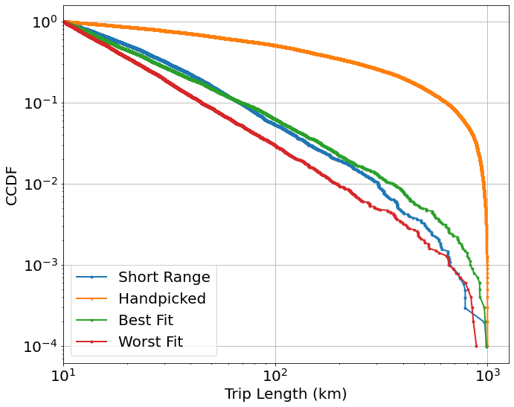
Refine Best Fit-Short Range in Nhts17-modelling between 10~1000km
Auto Driver in Nhts17
Datasize=10223
Best fit error:
2.4541859191288786
Worst fit error
10.456599131567252
eps_range=np.arange(0.75,0.95,0.01)
p_range=np.arange(0.35, 0.45, 0.01)
alp_range=np.arange(2.3, 2.7,0.05)
Error: Wasserstein distance (the earth mover’s distance,)
Largest distance=1000 and shortest>=10
# Samples:
Modelling(10000), Visualization(10000)
 | eps | p | alpha
Hand picked | 2 | 0.7 | 1.1
Best fit | 0.88 | 0.44 | 2.7
Worst fit | 0.75 | 0.35 | 2.7

Slide 21
Modelling of Long Range Data

Slide 22
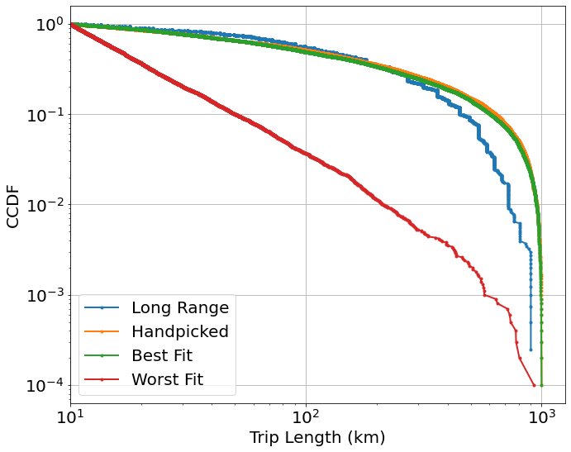
Re-modelling-Long Range Public in MiD 2017
Long Range Public in MiD 2017
Datasize=4048
Best fit error:
28.165133432795585
Worst fit error
162.91856611697713
eps_range=np.arange(0.1,2,0.05)
p_range=np.arange(0, 0.95, 0.05)
alp_range=np.arange(1.1, 2.5,0.05)
Error: Wasserstein distance (the earth mover’s distance)
Largest distance=1000 and shortest>=10
Samples:
Modelling(800), Visualization(10000)
 | eps | p | alpha
Hand picked | 2 | 0.7 | 1.1
Best fit | 1.75 | 0.75 | 1.15
Worst fit | 1.55 | 0.05 | 2.45

Slide 23
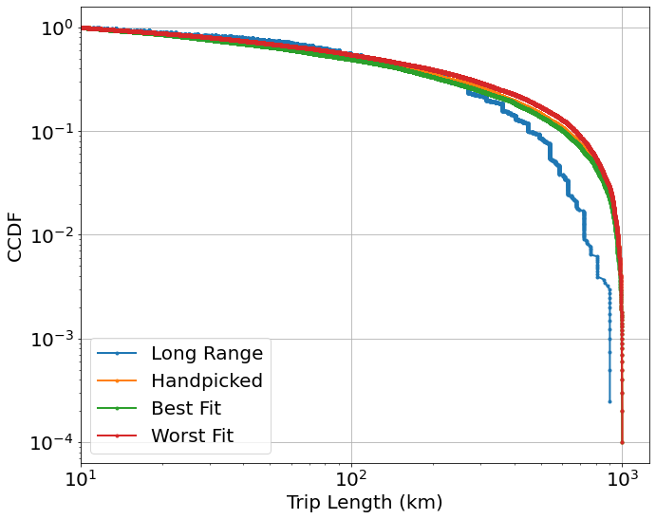
Refine Params-Long Range Public in MiD 2017
Long Range Public in MiD 2017
Datasize=4048
Best fit error:
34.879988032633655
Worst fit error
62.27091935642808
eps_range=np.arange(1.65,1.95,0.01)
p_range=np.arange(0.65, 0.85, 0.01)
alp_range=np.arange(1.1, 1.35,0.03)
Error: Wasserstein distance (the earth mover’s distance)
Largest distance=1000 and shortest>=10
Samples:
Modelling(3000), Visualization(10000)
 | eps | p | alpha
Hand picked | 2 | 0.7 | 1.1
Best fit | 1.75 | 0.81 | 1.25
Worst fit | 1.91 | 0.83 | 1.1

Slide 24
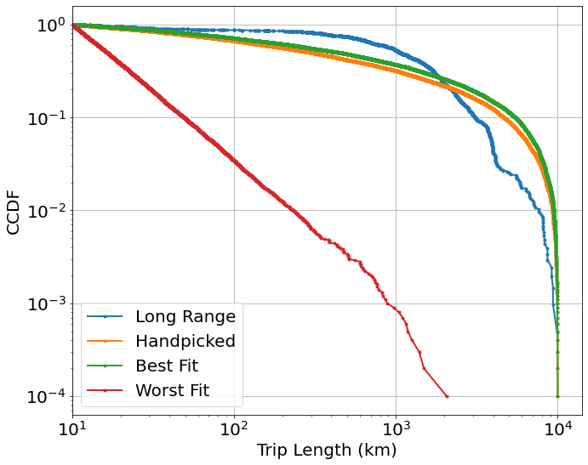
Re-modelling-Long Range Public in Nhts17
Long Range Public in Nhts17
Datasize=2055
Best fit error:
567.5103827730883
Worst fit error
1397.4969561038617
eps_range=np.arange(0.1,2,0.03)
p_range=np.arange(0, 0.95, 0.03)
alp_range=np.arange(1.1, 2.5,0.05)
Error: Wasserstein distance (the earth mover’s distance)
Largest distance=10000 and shortest>=10
Samples:
Modelling(800), Visualization(10000)
 | eps | p | alpha
Hand picked | 2 | 0.7 | 1.1
Best fit | 1.4 | 0.9 | 1.1
Worst fit | 0.7 | 0.05 | 2.45

Slide 25
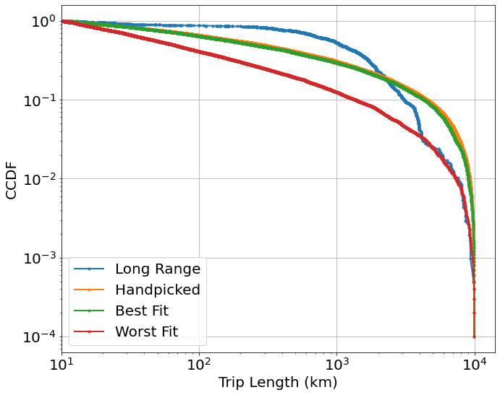
Refine Params-Long Range Public in Nhts17
Long Range Public in Nhts17
Datasize=2055
Best fit error:
617.4887883169575
Worst fit error
925.3654711091864
eps_range=np.arange(1.3,1.5,0.01)
p_range=np.arange(0.7, 0.95, 0.01)
alp_range=np.arange(1.1, 1.7,0.05)
Error: Wasserstein distance (the earth mover’s distance)
Largest distance=10000 and shortest>=10
Samples:
Modelling(3000), Visualization(10000)
 | eps | p | alpha
Hand picked | 2 | 0.7 | 1.1
Best fit | 1.34 | 0.86 | 1.25
Worst fit | 1.3 | 0.7 | 1.65

Slide 26
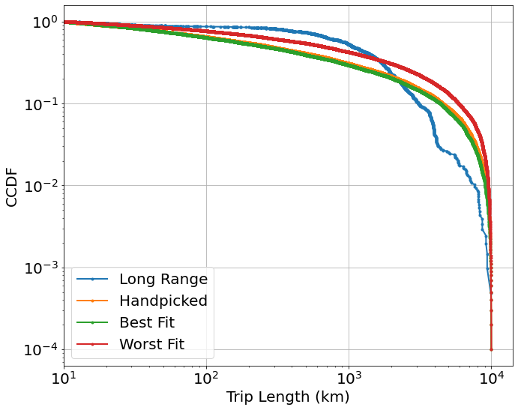
Refine Params-Long Range Public in Nhts17 different alpha
Long Range Public in Nhts17
Datasize=2055
Best fit error:
606.4643067765015
Worst fit error
862.5914644848104
eps_range=np.arange(1.3,1.5,0.01)
p_range=np.arange(0.7, 0.95, 0.01)
alp_range=np.arange(1.01, 1.3,0.01)
Error: Wasserstein distance (the earth mover’s distance)
Largest distance=10000 and shortest>=10
Samples:
Modelling(3000), Visualization(10000)
 | eps | p | alpha
Hand picked | 2 | 0.7 | 1.1
Best fit | 1.31 | 0.88 | 1.29
Worst fit | 1.45 | 0.94 | 1.02

Slide 27
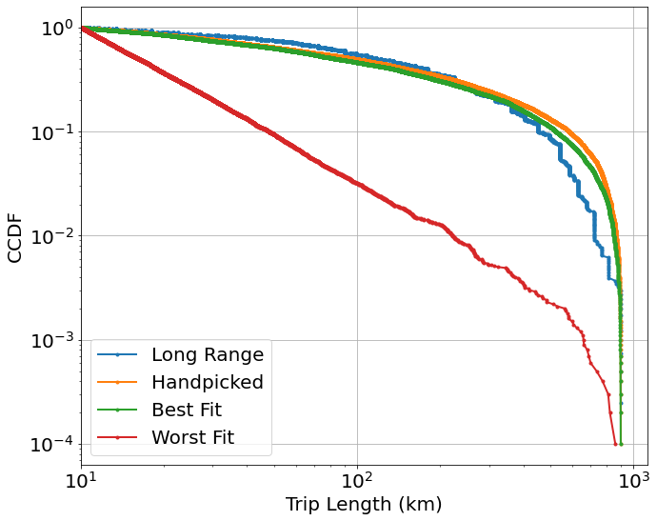
Long Range Public in MiD 2017 Limited range distances(10km~900km) selected for modelling
Datasize=4048
Best fit error:
22.905572791084737
Worst fit error
163.46889191591436
eps_range=np.arange(0.1,2,0.05)
p_range=np.arange(0, 0.95, 0.05)
alp_range=np.arange(1.1, 2.5,0.05)
Error: Wasserstein distance (the earth mover’s distance)
Samples:
Modelling(1000), Visualization(10000)
 | eps | p | alpha
Hand picked | 2 | 0.7 | 1.1
Best fit | 1.65 | 0.85 | 1.35
Worst fit | 0.15 | 0.15 | 2.45

Slide 28
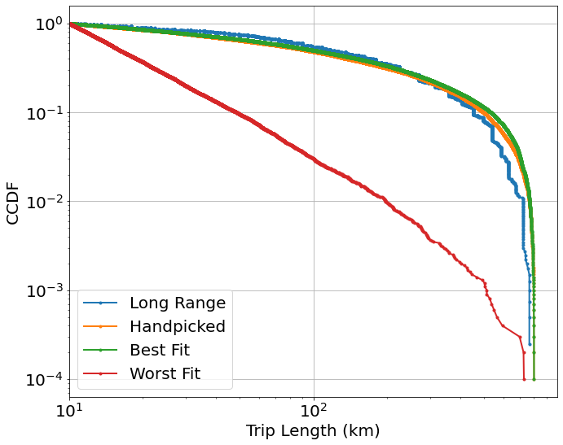
Long Range Public in MiD 2017 Limited range distances(10km~800km) selected for modelling
Datasize=4023
Best fit error:
16.91721769847116
Worst fit error
158.81007046088865
eps_range=np.arange(0.1,2,0.05)
p_range=np.arange(0, 0.95, 0.05)
alp_range=np.arange(1.1, 2.5,0.05)
Error: Wasserstein distance (the earth mover’s distance)
Samples:
Modelling(1000), Visualization(10000)
 | eps | p | alpha
Hand picked | 2 | 0.7 | 1.1
Best fit | 1 | 0.8 | 1.1
Worst fit | 0.5 | 0.2 | 2.45

Slide 29
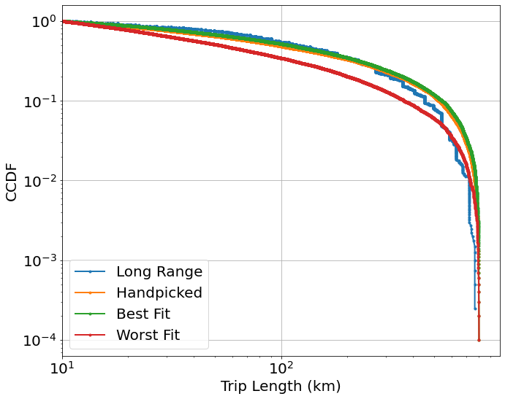
Refine params-Long Range Public in MiD 2017 Limited range distances(10km~800km) selected for modelling
Datasize=4023
Best fit error:
11.889220018901637
Worst fit error
71.16910467705088
eps_range=np.arange(0.3,1.5,0.03)
p_range=np.arange(0.7, 0.95, 0.03)
alp_range=np.arange(1.02, 1.3,0.01)
Error: Wasserstein distance (the earth mover’s distance)
Samples:
Modelling(1000), Visualization(10000)
 | eps | p | alpha
Hand picked | 2 | 0.7 | 1.1
Best fit | 0.54 | 0.88 | 1.03
Worst fit | 0.3 | 0.79 | 1.3

Slide 30
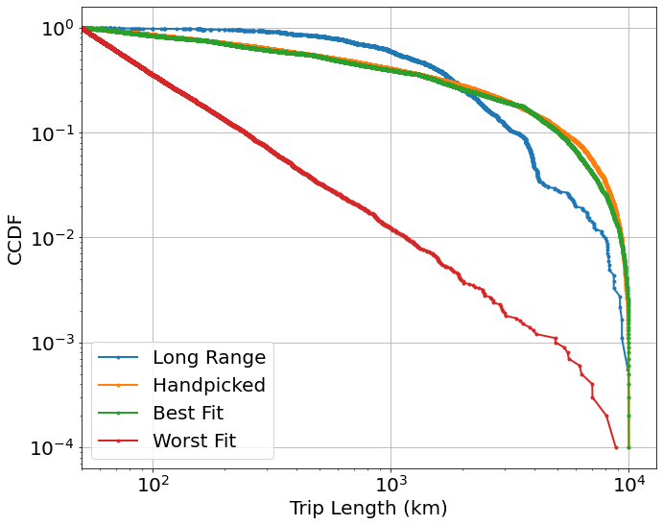
Long Range Public in Nhts17 Limited range distances(50km~10000km) selected for modelling
Datasize=1828
Best fit error:
567.0541960792283
Worst fit error
1473.23976344117
eps_range=np.arange(0.1,2,0.03)
p_range=np.arange(0, 0.95, 0.03)
alp_range=np.arange(1.1, 2.5,0.05)
Error: Wasserstein distance (the earth mover’s distance)
Samples:
Modelling(1000), Visualization(10000)
 | eps | p | alpha
Hand picked | 2 | 0.7 | 1.1
Best fit | 1.78 | 0.93 | 1.95
Worst fit | 0.94 | 0.12 | 2.45

Slide 31
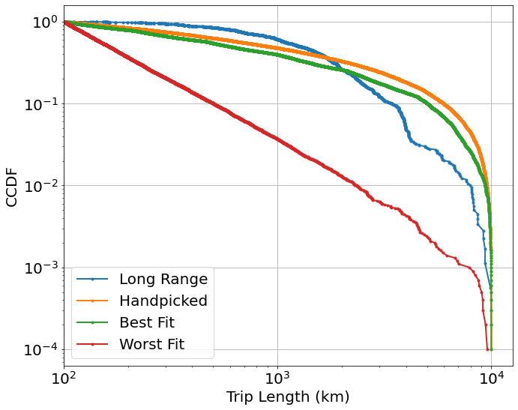
Long Range Public in Nhts17 Limited range distances(100km~10000km) selected for modelling
Datasize=1787
Best fit error:
508.09228867459035
Worst fit error
1396.189495821336
eps_range=np.arange(0.1,2,0.03)
p_range=np.arange(0, 0.95, 0.03)
alp_range=np.arange(1.1, 2.5,0.05)
Error: Wasserstein distance (the earth mover’s distance)
Samples:
Modelling(1000), Visualization(10000)
 | eps | p | alpha
Hand picked | 2 | 0.7 | 1.1
Best fit | 1.15 | 0.87 | 2.2
Worst fit | 0.85 | 0 | 2.45

Slide 32
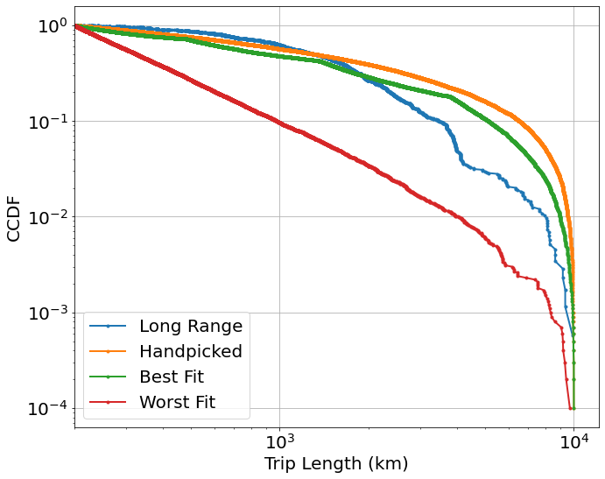
Long Range Public in Nhts17 Limited range distances(200km~10000km) selected for modelling
Datasize=1749
Best fit error:
436.40565342841455
Worst fit error
1179.1969821290425
eps_range=np.arange(0.1,2,0.05)
p_range=np.arange(0, 0.95, 0.05)
alp_range=np.arange(1.1, 2.5,0.05)
Error: Wasserstein distance (the earth mover’s distance)
Samples:
Modelling(1000), Visualization(10000)
 | eps | p | alpha
Hand picked | 2 | 0.7 | 1.1
Best fit | 1.8 | 0.8 | 2.45
Worst fit | 0.15 | 0.55 | 2.45

Slide 33
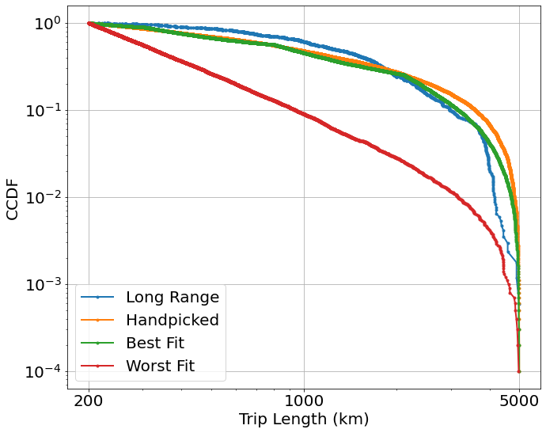
Long Range Public in Nhts17 Limited range distances(200km~5000km) selected for modelling
Datasize=1698
Best fit error:
208.76803608410893
Worst fit error
1044.3541416853718
eps_range=np.arange(0.1,2,0.05)
p_range=np.arange(0, 0.95, 0.05)
alp_range=np.arange(1.05, 2.5,0.05)
Error: Wasserstein distance (the earth mover’s distance)
Samples:
Modelling(1000), Visualization(10000)
 | eps | p | alpha
Hand picked | 2 | 0.7 | 1.1
Best fit | 1.6 | 0.9 | 2.35
Worst fit | 0.5 | 0.35 | 2.45

Slide 34
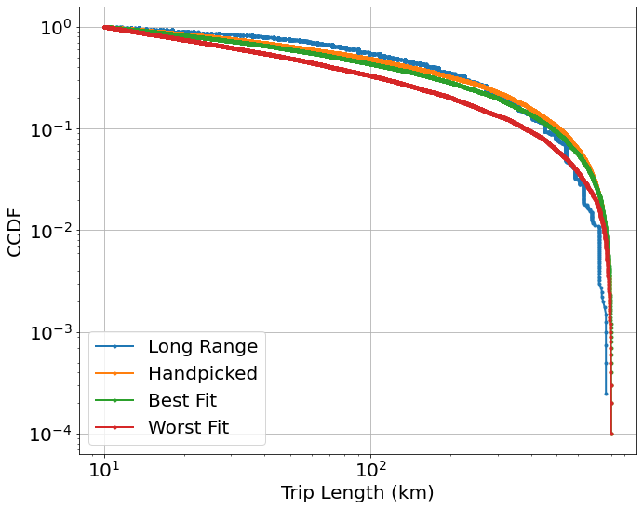
Refine params-Long Range Public in MiD 2017 Limited range distances(10km~800km) selected for modelling
Datasize=4023
Best fit error:
27.548129447794018
Worst fit error
63.79189100976263
eps_range=[1]
p_range=[0]
alp_range=np.arange(1.02, 1.3,0.01)
Error: Wasserstein distance (the earth mover’s distance)
Samples:
Modelling(1000), Visualization(10000)
 | eps | p | alpha
Hand picked | 2 | 0.7 | 1.1
Best fit | 1 | 0 | 1.06
Worst fit | 1 | 0 | 1.28

Slide 35
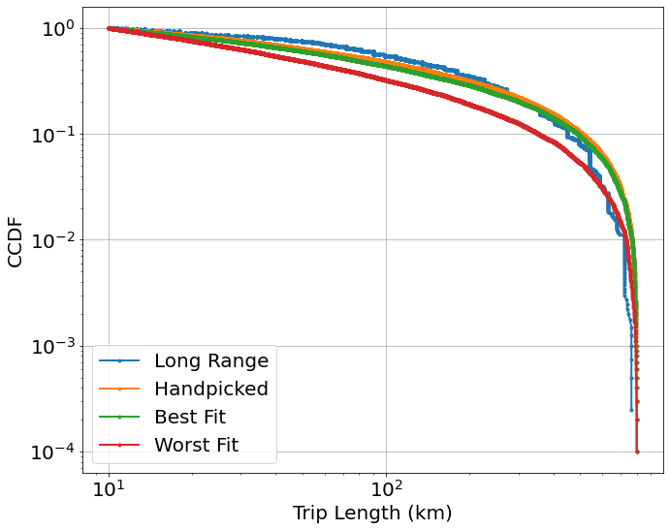
Refine params-Long Range Public in MiD 2017 Limited range distances(10km~800km) selected for modelling
Datasize=4023
Best fit error:
25.679310339679034
Worst fit error
70.89487709721118
eps_range= [1]
p_range= [0]
alp_range=np.arange(1.03, 1.3,0.005)
Error: Wasserstein distance (the earth mover’s distance)
Samples:
Modelling(1000), Visualization(10000)
 | eps | p | alpha
Hand picked | 2 | 0.7 | 1.1
Best fit | 1 | 0 | 1.075
Worst fit | 1 | 0 | 1.29

Slide 36
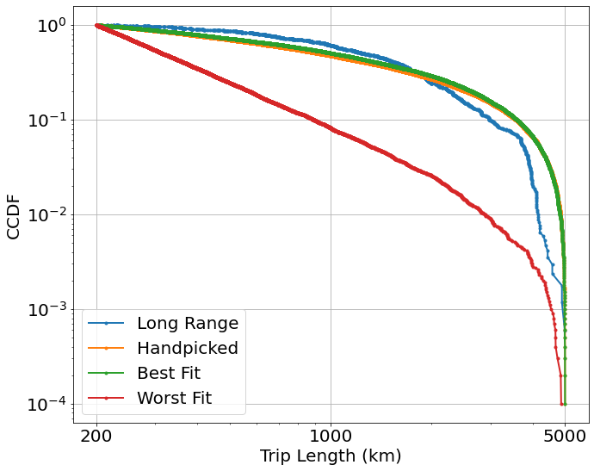
Long Range Public in Nhts17 Limited range distances(200km~5000km) selected for modelling
Datasize=1698
Best fit error:
277.1958103335053
Worst fit error
1025.1943744975401
eps_range=[1]
p_range=[0]
alp_range=np.arange(1.02, 2.5, 0.05)
Error: Wasserstein distance (the earth mover’s distance)
Samples:
Modelling(1000), Visualization(10000)
 | eps | p | alpha
Hand picked | 2 | 0.7 | 1.1
Best fit | 1 | 0 | 1.02
Worst fit | 1 | 0 | 2.47

Slide 37
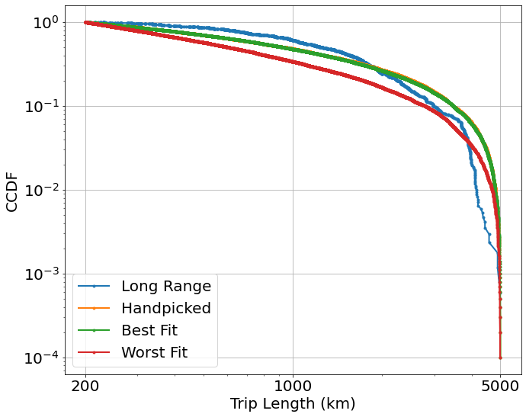
Long Range Public in Nhts17 Limited range distances(200km~5000km) selected for modelling
Datasize=1698
Best fit error:
250.3497826430402
Worst fit error
495.54404961892897
eps_range=[1]
p_range=[0]
alp_range=np.arange(1.02,1.5,0.01)
Error: Wasserstein distance (the earth mover’s distance)
Samples:
Modelling(1000), Visualization(10000)
 | eps | p | alpha
Hand picked | 2 | 0.7 | 1.1
Best fit | 1 | 0 | 1.05
Worst fit | 1 | 0 | 1.42

Slide 38
Covid 19

Slide 39
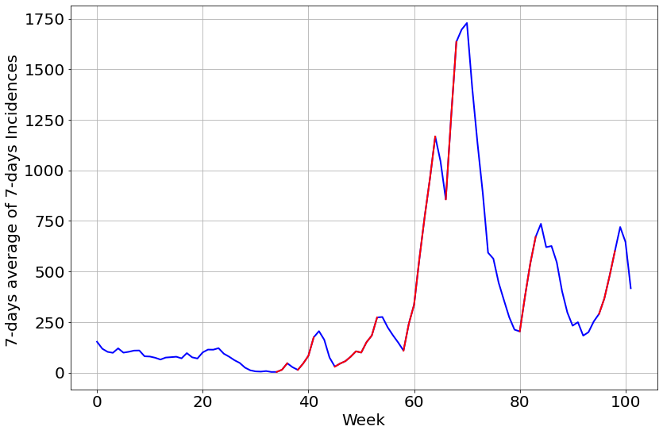
Coloring-LK Ahrweiler

Slide 40
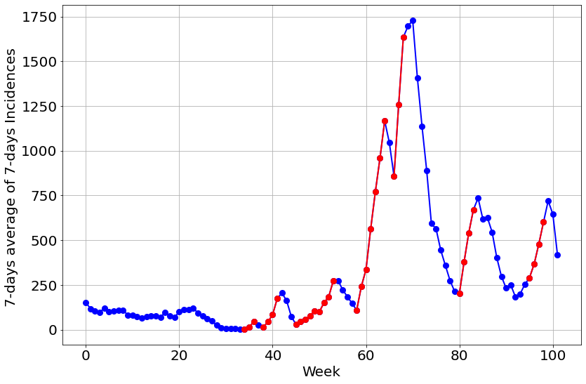
Coloring-LK Ahrweiler

Slide 41
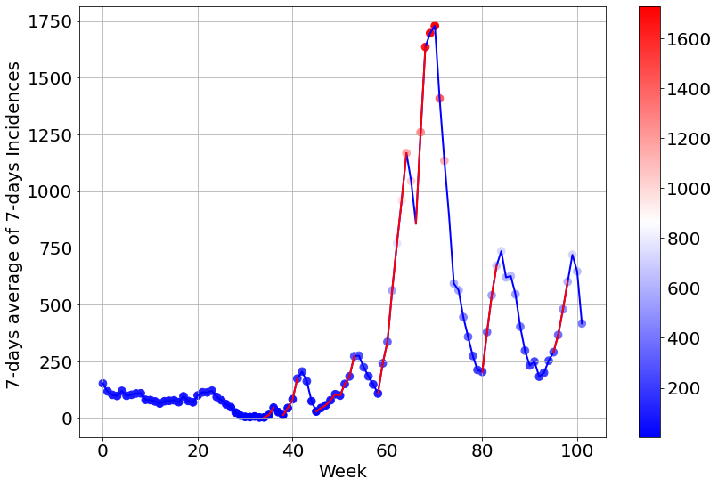
Coloring-LK Ahrweiler

Slide 42
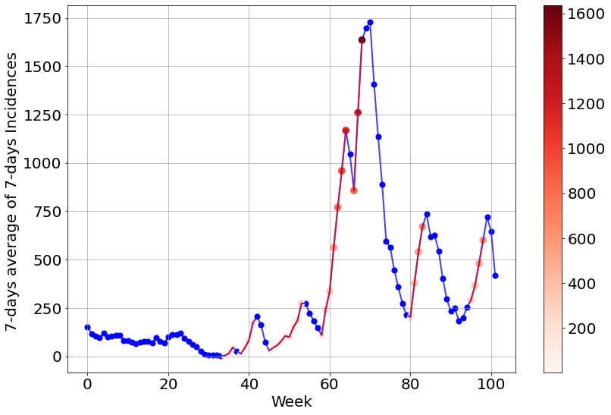
Coloring-LK Ahrweiler
3 weeks as a roll
Increase: from white to red

Slide 43
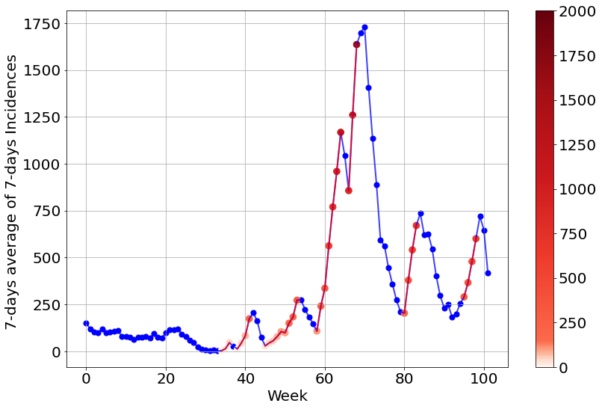
Coloring-LK Ahrweiler
3 weeks as a roll
Increase: from white to red – different scale of color bar

Slide 44
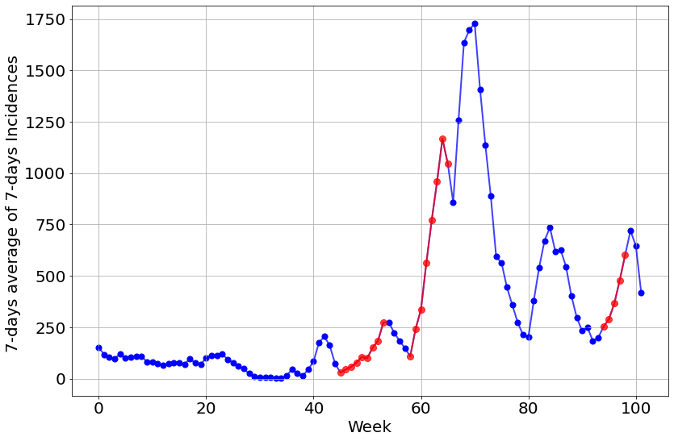
Coloring-LK Ahrweiler
5 weeks as a roll
Red line: At least 4 weeks in which we have increased by a factor of 1.2

Slide 45
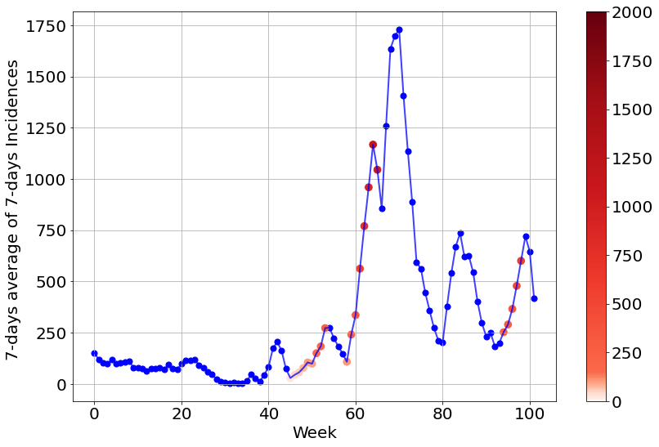
Coloring-LK Ahrweiler
5 weeks as a roll, Increase: from white to red
Red line: At least 4 weeks in which we have increased by a factor of 1.2

Slide 46
Incidence Formulas
Incidence= (New Cases) / (Population x Timeframe)
7-day incidence rate per 100,000
Cases in 7 days / Population x 100000
Berlin | Population | Percentage in Berlin
SK Berlin Charlottenburg-Wilmersdorf | 334401 | 0.091130
SK Berlin Friedrichshain-Kreuzberg | 282059 | 0.076866
SK Berlin Lichtenberg | 286522 | 0.078082
SK Berlin Marzahn-Hellersdorf | 262967 | 0.071663
SK Berlin Mitte | 375238 | 0.102259
SK Berlin Neukölln | 321123 | 0.087512
SK Berlin Pankow | 398036 | 0.108472
SK Berlin Reinickendorf | 259689 | 0.070770
SK Berlin Spandau | 239019 | 0.065137
SK Berlin Steglitz-Zehlendorf | 302177 | 0.082348
SK Berlin Tempelhof-Schöneberg | 341772 | 0.093139
SK Berlin Treptow-Köpenick | 266488 | 0.072623
Calculated from the original table: Fallzahlen_Kum_Tab_Archiv.xlsx
(https://www.rki.de/DE/Content/InfAZ/N/Neuartiges_Coronavirus/Daten/Inzidenz-Tabellen.html?nn=2386228)

